Slide 1
“CATAPULT TO INDEPENDENCE”
Cholpon Chotaeva
Anthropology, AUCA

Slide 2
Contents
Political development under Akaev
Economic development under Akaev
Foreign policy under Akaev
“Tulip Revolution” of 2005
Political development under Bakiev
Economic development under Bakiev
Foreign policy under Bakiev
2010 revolution
2010 interethnic conflict
Political development after 2010
Foreign policy after 2010
Conclusion

Slide 3
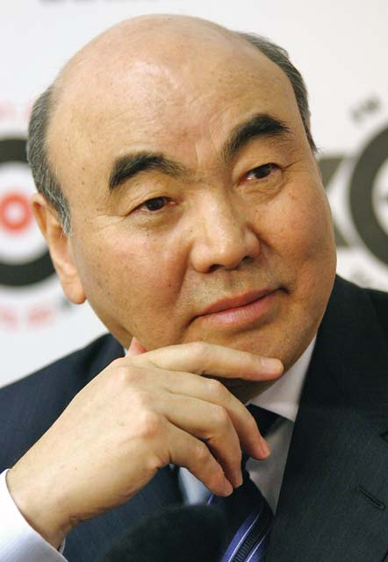
October 1991 –
Akayev was reelected the president in referendum (95%)

Slide 4
Political development under Akaev
March 1991- referendum on the preservation of the USSR (88.7% to remain in the USSR)
August 19, 1991 – the coup by the State Emergency Committee (putch)
August 31, 1991 – Declaration of Independence of the Republic of Kyrgyzstan
December 8, 1991 – Russia, Belarus and Ukraine met in Belovezhskaya Pushcha and signed the creation of the Commonwealth of Independent States
December 21, 1991 – Akaev signed the creation of the Commonwealth of Independent States in Almaty
December 25, 1991 – the USSR President Gorbachev resigned

Slide 5


Political development under Akaev
1992-1994 – Kyrgyz national symbols:
flag, anthem, emblem, adopted by
the Legendary Parliament
May 5, 1993 – Consitution was adopted
The Constitution declared:
“Kyrgyzstan is a sovereign unitary democratic republic built on the basis of legal secular state”
1993 – the official name is
the Kyrgyz Republic

Slide 6
Branches of power
President (a five-year term, 35-65 years old, speak Kyrgyz, 15 years in Kyrgyzstan, not more than twice)
Legislative branch:
Parliament Jogorku Kenesh – a five-year term office
Local councils

Slide 7
Branches of power
Executive branch:
Prime Minister
Cabinet of Ministers
Ministries
State agencies
Local administration:
governors in provinces, akims in rayons and cities, ayl okmotus in villages

Slide 8
Branches of power
Judicial branch:
Constitutional Court
Supreme Court
Supreme Arbitration Court
Local courts

Slide 9
Political development under Akaev
October 1994 - referendum approved new amendments to the Constitution and the creation of a bicameral parliament
March 1995 - the new bicameral parliament was elected (35-seat full-time Legislative Assembly and the 70-seat part-time Assembly of People's Representatives)
1995 - Akayev was reelected for another 5-year term (75%)
1996 - new amendments to the Constitution to increase the power of the president

Slide 10
Political development under Akaev
2000 - Akayev was reelected for another 5-year term based on the decision of the Consitutional Court
2003 – new amendments to the Constitution to increase the power of the president
2005 - elections to a unicameral parliament were not free and fair
March 24, 2005 – “Tulip Revolution”

Slide 11
Economic development under Akaev
1993 – the new Kyrgyz currency som introduced
1991 - the Denationalization and Privatization Law by the State Property Fund (33% enterprises, 82% trade enterprises, 68% construction assets)
1994 - the Privatization Law: privatization of medium-sized and large enterprises (competitive cash bidding among individuals)

Slide 12
Economic development under Akaev
1991 - an agrarian reform: disintegration of collective farms and creation of peasant farms (1993 - 172 collective farms were dissolved and 17.5 thousand peasant farms created)
1994 - the President Decree on deepening the agrarian reform (1998 - 55 thousand peasant farms were created as well as agricultural cooperatives, collective peasant farms, joint enterprises)
1995 - land tax introduced
1998 – privatization of land
2000 - the law allowed purchasing and selling land

Slide 13
Foreign policy under Akaev
135 states recognized Kyrgyzstan
96 states established diplomatic relations
20 Kyrgyzstani embassies and consulates
1992 – the USA embassy in Kyrgyzstan
1992 – the United Nations member
71 international organizations

Slide 14
Foreign policy Akaev
Principles:
Strengthening international relations
Following neutrality and non-participation principles in military blocks
Eradication and prevention of interethnic conflicts
Creation of a favorable image of the country
Competitiveness at the international arena

Slide 15
“Tulip Revolution”
March 24, 2005 – the events resulted in the overthrow of Akaev regime
Reasons:
Political: family rule, authoritarianism
Economic: economic crisis, corruption
Social: poverty, unemployment
Regionalism and tribalism
Pretext: 2005 parliamentary elections

Slide 16
Political development under Bakiev
July 2005 - Bakiev was elected the president because of “Bakiev-Kulov tandem”
2005-2007 – demands for the new amendments to the Constitution to establish the parlimentary system
2007 – the new amendments to the Consitution increased the power of the president
2007 – the parliamentary elections according to parties
2009 - Bakiev was reelected for another 5-year term (83.8%)
April 7, 2010 – the Second Revolution

Slide 17
Economic development under Bakiev
Kambar-Ata Hydroelectric Station
2006 – debate on World Bank and International Monetary Fund’s Heavily Indebted Poor Countries (HIPC)
2009-2010 - Energy crisis

Slide 18
Foreign policy under Bakiev
2007– the new concept of the Foreign Policy defined the foreign policy of Kyrgyzstan as multi-vectored, balanced and pragmatic policy based on the national interests, natural resources and possibilities of the country

Slide 19
Foreign policy under Bakiev
Issues:
Border issue (China, Kazakhstan, Tajikistan, Uzbekistan)
Energy and water (Kazakhstan, Uzbekistan, Tajikistan)
Economy and trade (Russia, Kazakhstan, China, IMF, WB)
Security (Russia, Kazakhstan, Uzbekistan, Tajikistan, China, Turkey, USA) – SCO, Manas airbase, Kant airbase

Slide 20
2010 Revolution
April 7, 2010 – the events resulted in the overthrow of Bakiev regime
Reasons:
Political: family rule, authoritarianism
Economic: economic crisis, corruption
Social: poverty, unemployment
Regionalism and tribalism
Pretext: 2009 presidential elections

Slide 21
2010 interethnic conflict
June 2010- the clashes between Kyrgyzs and Uzbeks in Osh and Djalal-Abad provinces
Reasons:
Political: instability, ethnic nationalism
Economic: economic crisis
Social: poverty, unemployment,
Cultural: language, education
Pretext: rumors
Results: 300,000 people displaced
100,000 refugees to Uzbekistan
500 people killed (by official estimations)

Slide 22
Political development after 2010
April 2010 – Provisional Government was formed
June 2010 – a referendum to establish the parliamentary system
President of Transitional Period –Otumbaeva (2010-2012)
2011 Parliament: “ Social Democrats”, “Ar Namys”, “Respublika”, “ Ata Jurt”, “Ata Meken”
Coalition government: “Social Democrats”, “Respublika”, “ Ata Jurt”
Prime Minister – Atambaev

Slide 23
Political development after 2010
2011 – Atambaev was elected the president, peaceful transition of power
Coalition government: “Respublika”, “Social Democrats”, “Ata Meken”, “Ar Namys”
Prime Minister – Babanov
2012 coalition collapse and resignation of the government
2012 coalition government: “Social Democrats”, “Ata Meken”, “ Ar Namys”
Prime Minister – Satybaldiev
The Program of the Kyrgyz Republic Development for 2012-2014 initiated by the government
The plan of activities for 100 days on the implementation of the Program of the Government

Slide 24
Foreign policy after 2010
Statements on the functioning of “Manas” Transit Centre till 2014
Strategic partnership with the Russian Federation
Mutual collaboration with Turkey

Slide 25
Conclusion
Independence was unexpected to Central Asians
Kyrgyzstan managed to create its political and economic systems
Kyrgyzstan faced many challenges such as interethnic conflicts, the border issue, migration, the security issue, tribalism

Slide 26
Reading
Martha Brill Olcott ‘Central Asia’s Catapult to Independence’

Slide 27
Make-up classes
No classes on November 7 and 8
Make-up classes on November 13 (Wed):
9:25 in Room 119 (Thu 10:50)
12:45 in Room 119 (Fri 10:50)

Slide 28
Museum Essay
Deadline is November 8, 6 pm

